Slide 1
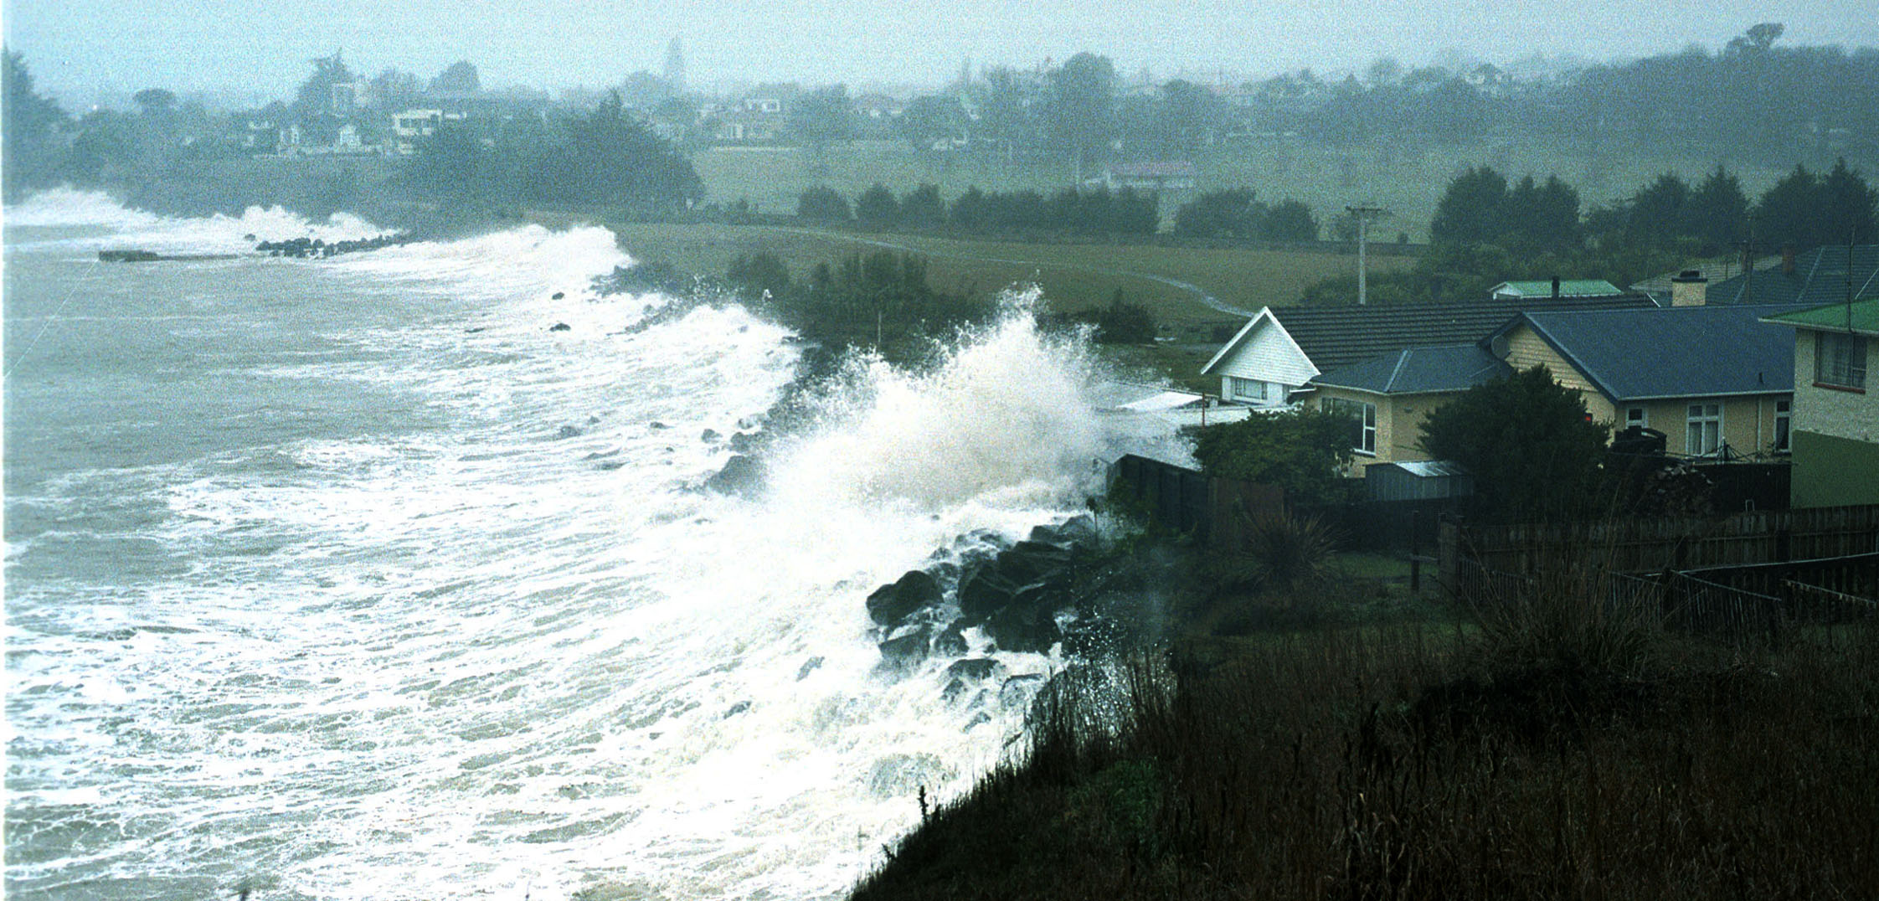
Metamodeling for Vigilance Vagues- Submersion by integrating functional inputs and outputs
Paul SLISSE
Victor DAVODEAU

Slide 2
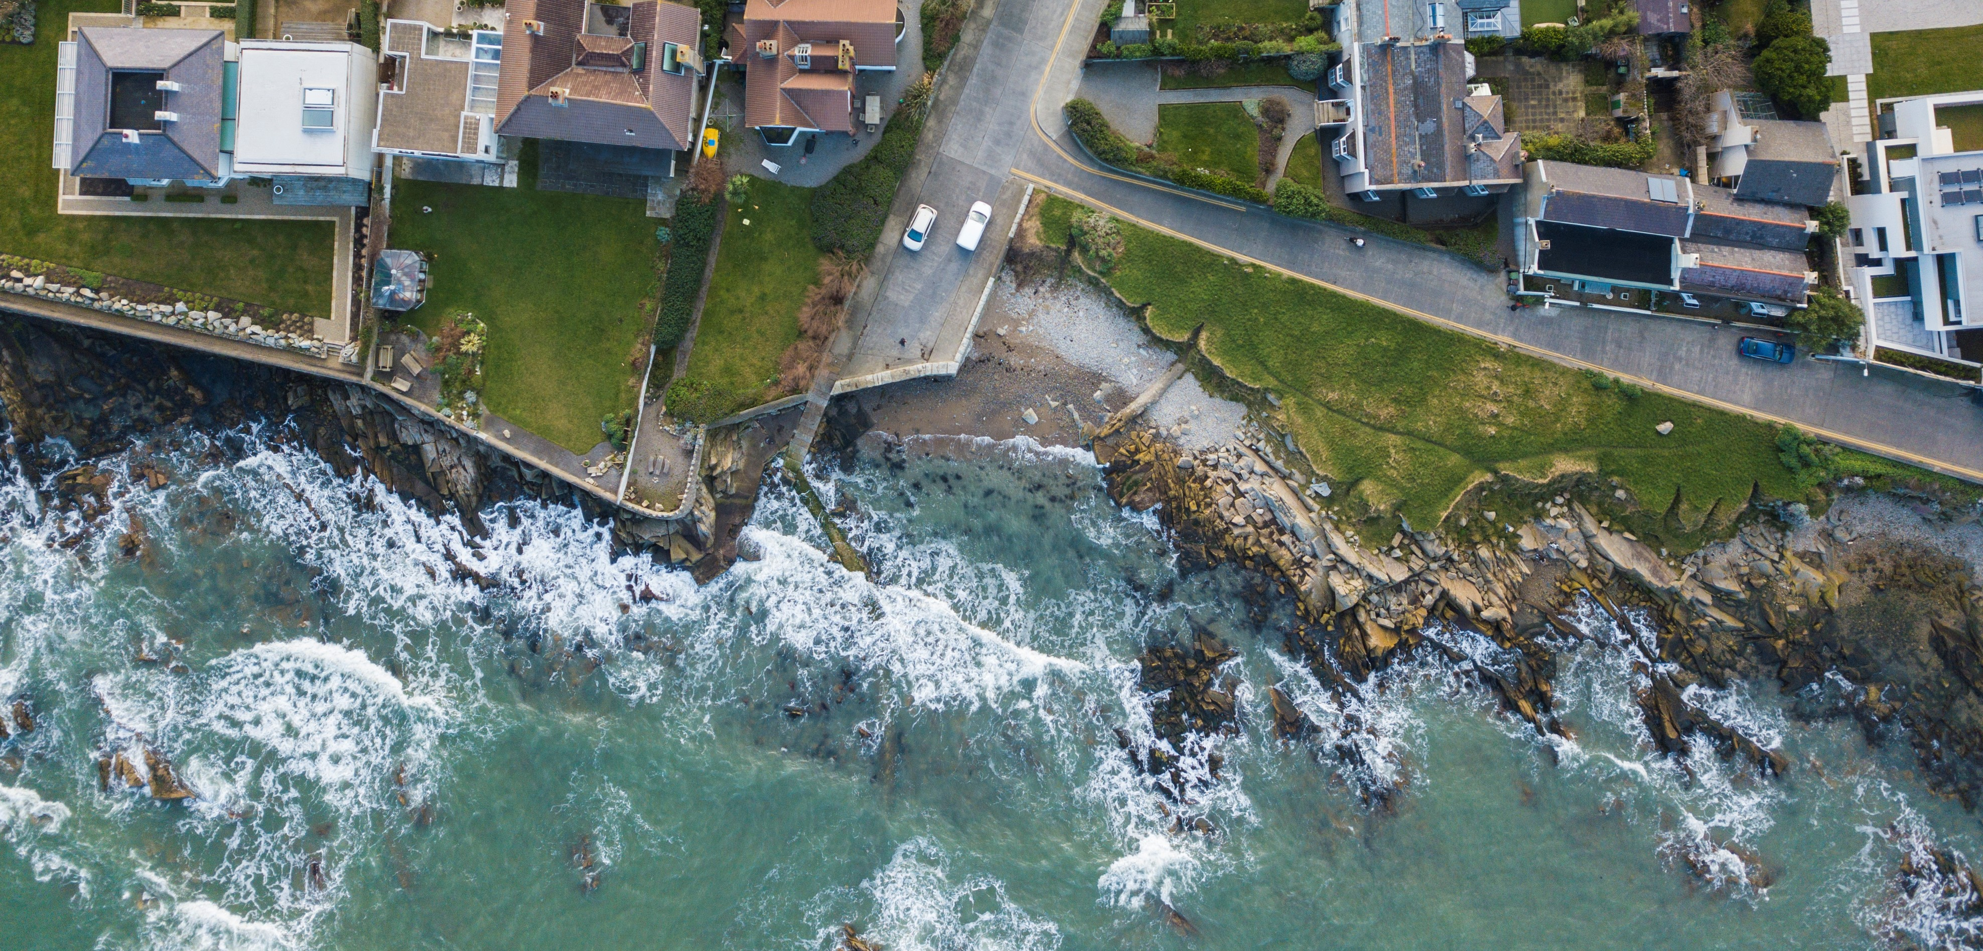

Predict the risk of coastal flooding locally and in real time
Notes:
« Problem slide with regular words »

Slide 3
Implement a metamodel that can give a real-time prediction on a local scale

